Slide 1

Shopper Spectrum: Customer Segmentation & Product Recommendation
This project transforms raw retail data into meaningful customer insights and product recommendations.

Slide 2
Project Objectives
1
2
3
Customer Behavior Analysis
Customer Segmentation
Product Recommendation
Analyze e-commerce customer purchasing patterns.
Segment customers using RFM analysis and K-Means clustering.
Recommend similar products via Item-based Collaborative Filtering.

Slide 3

Dataset & Preprocessing
Dataset Summary
Data Preprocessing
Source: Online Retail Dataset
Removed missing CustomerIDs
Features: InvoiceNo, StockCode, Description, Quantity, InvoiceDate, UnitPrice, CustomerID, Country
Filtered for positive quantities and prices
Converted InvoiceDate to datetime
Data Size: ~500K transactions
Created RFM features (Recency, Frequency, Monetary)

Slide 4




Exploratory Data Analysis (EDA)
Top-Selling Products
Monthly Revenue Trends
Identified products with the highest sales volume.
Analyzed revenue fluctuations over time.
Most Active Customers
Geographic Sales
Highlighted customers with frequent engagement.
Mapped sales distribution across different countries.

Slide 5
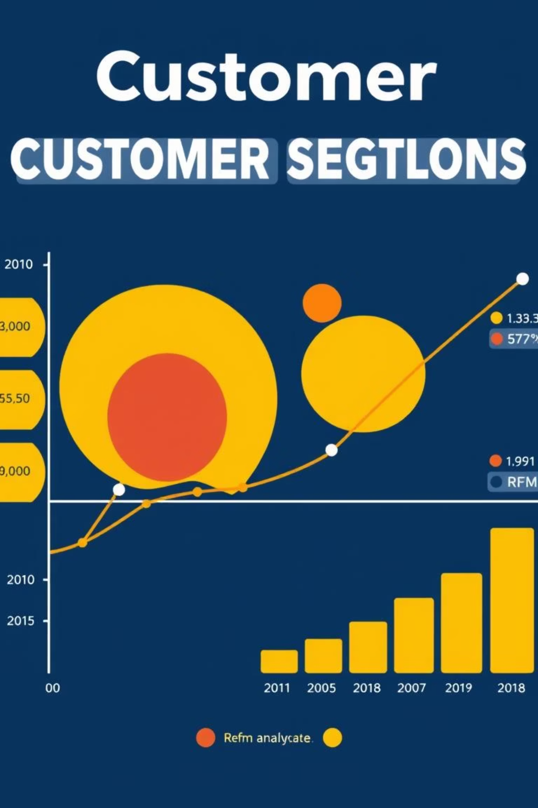
RFM Customer Segmentation
RFM Metrics
Clustering & Interpretation
Recency: Days since last purchase
Scaled features with StandardScaler
Frequency: Total number of purchases
Applied K-Means clustering (k=4)
Monetary: Total spend per customer
Segments: Loyal, New, At-risk, Occasional Buyers

Slide 6




Product Recommendation System
Technique
Similarity Matrix
Input & Output
Item-based Collaborative Filtering.
Created using cosine similarity.
Product name input, top 5 similar products output.

Slide 7
Model Files & Technologies
Model Files (Pickle)
Technologies Used
kmeans_model.pkl
Python: Pandas, NumPy, Scikit-learn
scaler.pkl
Visualization: Matplotlib, Seaborn
segment_map.pkl
App Interface: Streamlit
item_similarity_matrix.pkl
Deployment Prep: Pickle, Streamlit
description_to_stockcode.pkl
Notebook: Jupyter

Slide 8

Streamlit Web App Features
Customer Segmentation
Product Recommendation
Input: R, F, M values
Input: Product name
Output: Predicted Customer Segment
Output: Top 5 recommended items

Slide 9
Project File Structure
Shopper Spectrum/├── app.py├── Shopper_Spectrum_Complete_Analysis.ipynb├── recommendation.py / segmentation.py├── *.pkl (5 model/data files)├── requirements.txt└── README.md
A well-organized file structure ensures easy navigation and deployment of the project.

Slide 10
Final Results & Outcomes
Actionable Customer Groups
Functioning Recommender
Successfully segmented customers for targeted strategies.
Built a robust product recommendation system.
Integrated Web App
Ready for Deployment
Models integrated into a clean Streamlit application.
Project is prepared for business use and further development.
"Transforming raw retail data into meaningful customer insights and recommendations."

